Slide 1
Fertilizer 101
Name
Date

Slide 2
About Me
Where I work
Job title
A little about me
Notes:
Hi, my name is __________________ and I work for ___________________ doing ____________________.
Introduce a little about yourself (Ex. You can share the town you live in, school you attended if local, highlight of the grade of the classroom you are in to make yourself relatable, something about your family, hobbies)
We will talk a little more about my career later.

Slide 3
Notes:
To view a demonstration of this activity, go to: YOUTUBE of Rick’s demo.
Visual Aids: Three hats, shirts, or name tags each labeled with one of the primary nutrients N, P, or K. Ideally, have N in green, P in yellow and K in pink/red. Fertilizer bag or label to show the nutrients. Optional: Nutrients for Life NPK poster. Kit can be obtained from Nutrients for Life
It doesn’t matter if it’s corn in the Midwest, bananas in Hawaii, strawberries in Florida, or almonds in California, every plant needs three main nutrients to survive.
No matter what you grow, it needs the three primary nutrients N, P and K. In science, we call nitrogen “N.” Can I get a volunteer? (Give them the hat with the “N”). About 78% of earth’s atmosphere is made of nitrogen. However, most plants can’t use the nitrogen directly from the air. So, scientists have figured out a way to make it into a form that plants can use, the Haber-Bosch process, through various types of fertilizers. How do you think nitrogen helps plants? Plants need nitrogen to be green and healthy. Without nitrogen, plant leaves will be weak and yellow. Some plants require a lot of Nitrogen, so N is the first member of the NPK team.
Can I get another volunteer? (Give them the hat with the “P”). The 2nd member of the team is P, which stands for Phosphorus. What color is the hat? Yellow! Why do you think our phosphorus hat is yellow? Without phosphorus the plant cannot conduct Photosynthesis. The leaves of a plant take in energy from the sun and turn it into energy for the plant. This is called photosynthesis. Phosphorus also helps encourage plants to grow strong and healthy roots, as well as helps the plant produce quality seeds, flowers, and fruit. Phosphorus can even help a plant resist disease, too.
Can I get one final volunteer? (Give them the “K” hat). Scientists call Potassium K. Potassium when mined looks like a pink rock. It’s mined either underground in the southeastern part of the United States or in the mountains in the northwest region. Potassium protects plants against diseases and helps the plants when it is cold or dry. It also helps the food you buy stay fresh.
Have students give the NPK Team volunteers a round of applause.
**Optional questions include asking students what each N, P and K stands for as well as why it’s needed by the plant as a review.
How do farmers add these nutrients back to the soil if they are missing? Fertilizers! Show students a fertilizer bag or label and explain the three numbers represented on the bag. Every plant needs a specific amount of these nutrients, similar to a recipe when cooking. Some need more nitrogen, some need more phosphorus. Farmers send soil samples to agronomists, or a soil scientist, to find out how much fertilizer they need to add to their fields. They don’t want too little or their plants won’t grow well, and they don’t want too much because that could hurt their plants too. Farmers strive to be environmentally friendly, as well as economical.

Slide 4
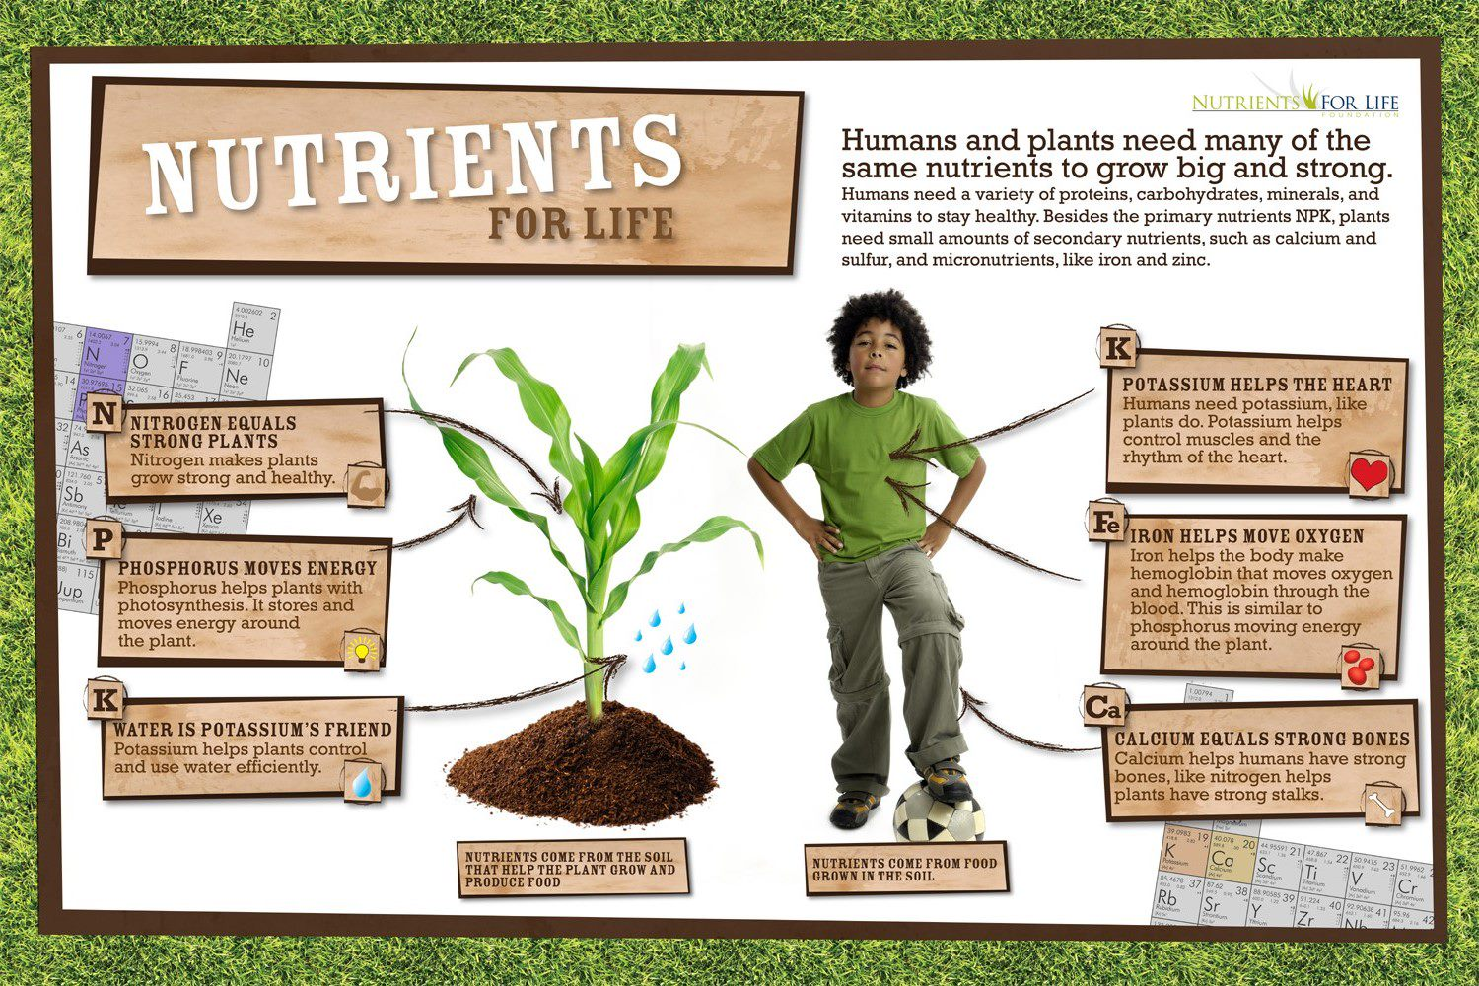
Notes:
Ask students, “where do we get these nutrients for our bodies?” We get N, P and K from the plants that we eat and the plants got the nutrients from the soil. Use the NFL NPK poster as a visual aid to reiterate.
Healthy soil=healthy plants and healthy plants=healthy people

Slide 5
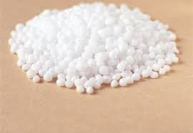
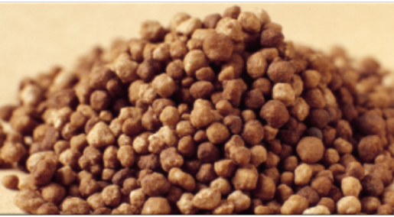
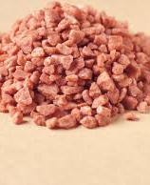
Nitrogen, Phosphorus, Potassium
COMES FROM ANCIENT SEA LIFE
COMES FROM THE AIR
COMES FROM
EVAPORATED
OCEANS
Notes:
Now that we have talked about our three essential elements, N, P, and K, where do these elements come from? The come from Nature!

Slide 6
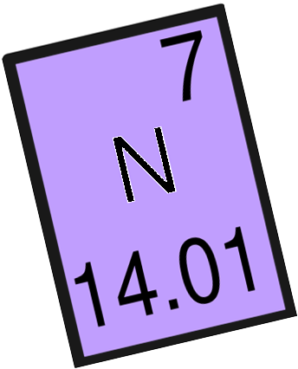
What is Nitrogen?
Promotes plant growth and is required for every process including chlorophyll production and photosynthesis.
Nutrient Deficiency Symptoms
Yellow hue to the leaves and weak stem
Notes:
(Optional Slide)
Nitrogen is the first of the macro (or basic) nutrients that a plant needs. Nitrogen makes plants grow strong and healthy. It is also used for chlorophyll production and photosynthesis. Nitrogen helps with rapid growth, increases leaves, seeds, and fruit production in plants.
If plants don’t have enough nitrogen, the leaves will start to turn greenish- yellow.

Slide 7
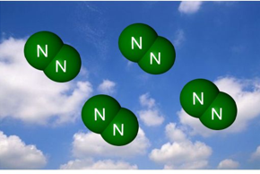
Where is nitrogen found in the environment?
The largest single source of nitrogen is the atmosphere
Nitrogen (N2) makes up 78% of the air we breathe.
Completely unusable to humans and animals!
Notes:
Nitrogen is found in the atmosphere and makes up 78% of the air we breathe, however this Nitrogen isn’t in a form that is usable by plants.

Slide 8
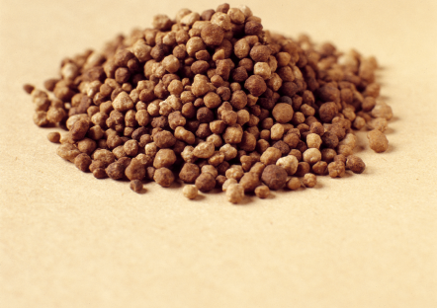
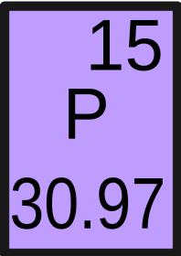
What is Phosphorus?
Phosphorus helps plants breathe, using photosynthesis
It also helps plants to store and move energy
Nutrient Deficiency Symptoms
Purple hue to leaves and stems
Notes:
(Optional Slide)
Phosphorus is also a macronutrient and a basic need for all plants. It helps breathe during photosynthesis while also helping the plant store and move energy. Phosphorus is also important for drought and disease tolerance.
Without this nutrient, plants won’t grow very tall and their leaves will turn purple.
Optional: Phosphorus is also involved in the formation of oils, sugars and starches in plants.

Slide 9
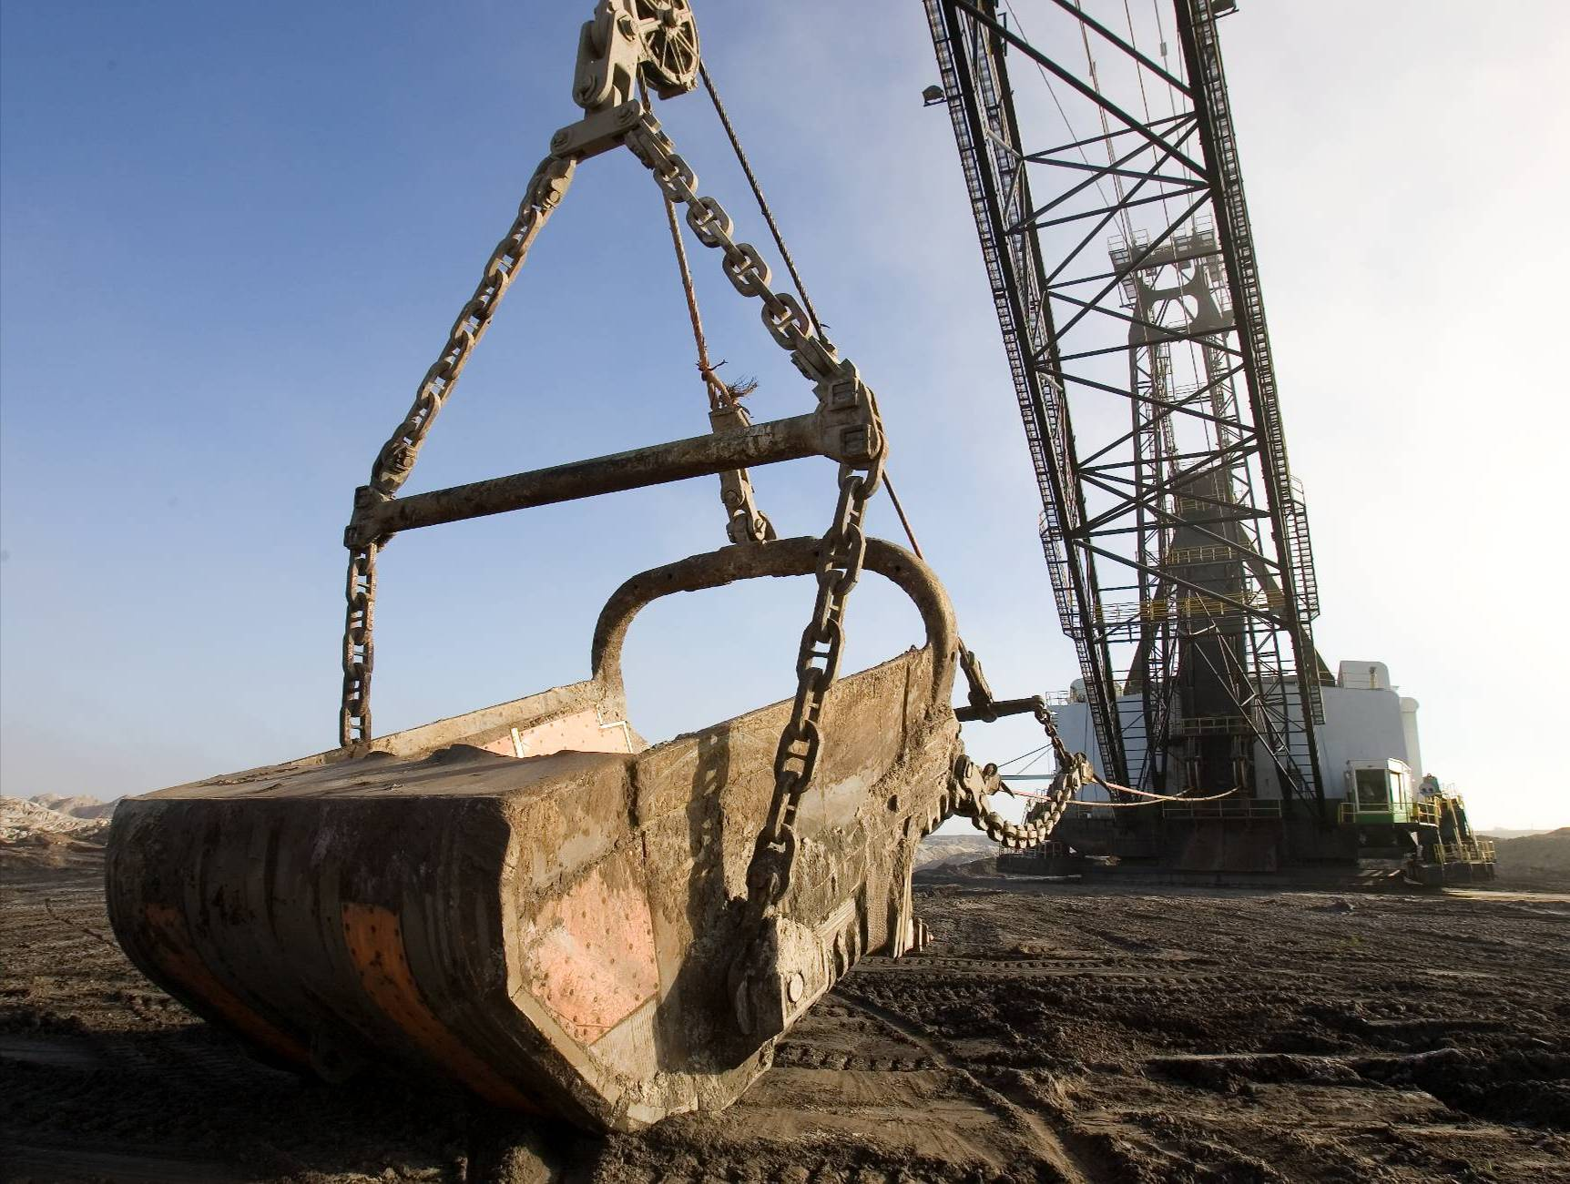
Phosphate
Source: Mosaic
Notes:
Phosphate is mined in four states in the United States, Idaho, Utah, North Carolina and Florida. This picture here shows a dragline mining phosphate in the Eastern United States.
**Optional if time permits show Nutrients for Life Phosphate mining video:
Elementary version: https://www.youtube.com/watch?v=KjmfpgBloAM&t=13s
Middle/High School version: https://www.youtube.com/watch?v=PSFQJiNiCXg&t=69s

Slide 10
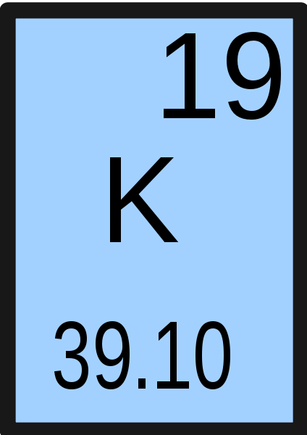
What is Potassium?
Potassium helps plants fight off disease
Potassium helps plants control and use water efficiently
Without potassium, plants may become infected from pests and could die off in the winter
Notes:
(Optional Slide)
Potassium is the last of the macronutrients that plants need. Potassium is especially important as it helps plants fight off disease while also making sure the plant is efficient in using water.
It can also regulate the transfer of nutrients throughout a plant while building proteins and increases the quality of fruit.
Without potassium, plants may become infected from pests and could die off during the winter.

Slide 11
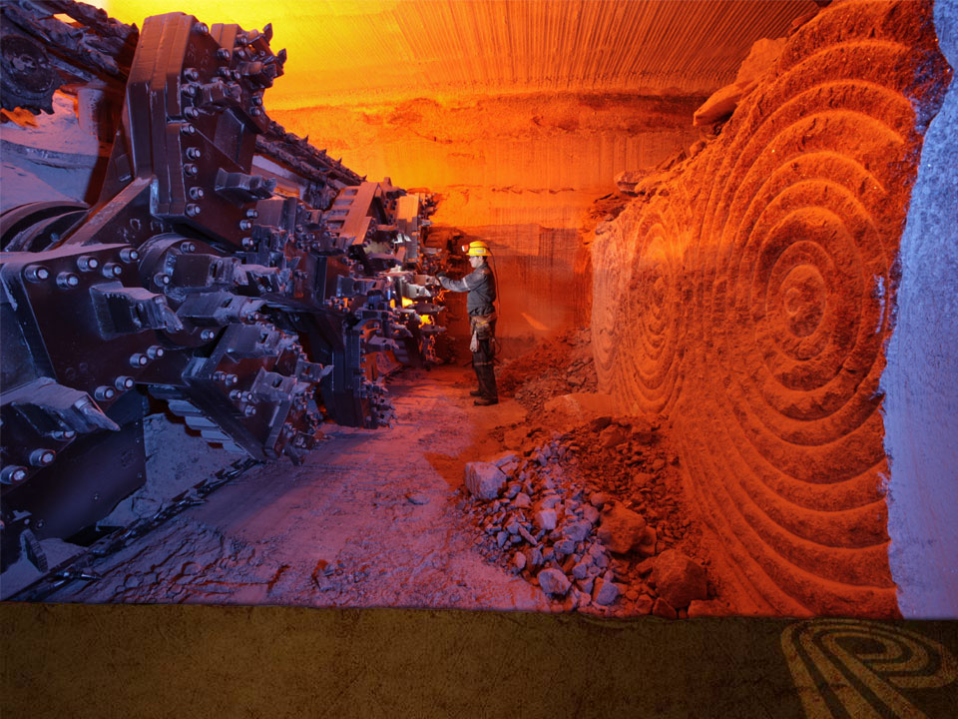
POTASH
Notes:
This picture shows a Potash mine deep under the Earth’s surface.
**Optional if time permits, show Nutrients for Life Potash mining video- https://www.youtube.com/watch?v=uujIepkI6Ow&t=182s

Slide 12
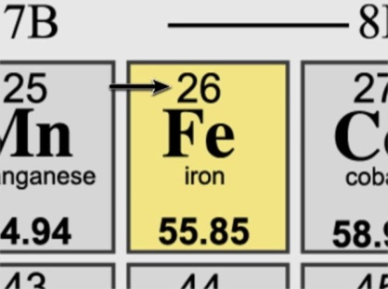
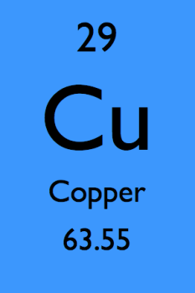
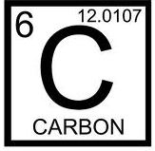
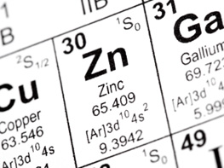
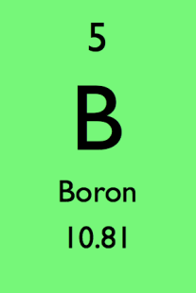
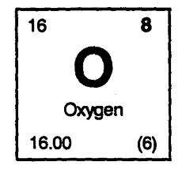
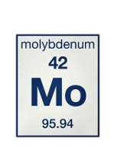
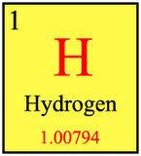
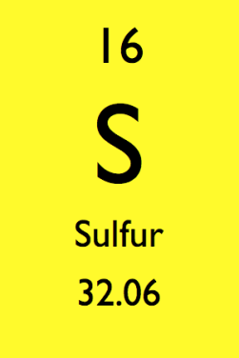
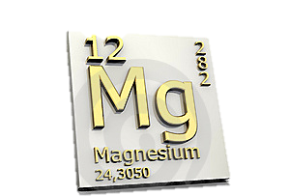
17 Essential Nutrients
Notes:
NPK are the basic nutrients that plants need to thrive, however there are 14 other nutrients that plants require to stay completely healthy.
Those nutrients are:
Calcium (Ca) – important for plant metabolism and essential for cell walls
Magnesium (MG) – helps with photosynthesis
Sulfur (S) – helps with protein production and improves root growth and cold tolerance.
Boron (B) – Regulates flowering, pollination and seed development
Chlorine (Cl)– aids in plant metabolism
Copper (Cu) – important for reproductive growth
Iron (Fe) – essential for the formation of chlorophyll
Manganese (Mn) – breaks down carbohydrates
Molybdenum (Mo) – helps with nitrogen efficiency
Nickel (Ni) – essential for plant hormones and cell membrane function
Zinc (Zn) – regulates enzymes
Hydrogen (H) – critical component of water
Oxygen (O) – needed for respiration and photosynthesis
Carbon (C) – life is made up of carbon chains and is essential for life

Slide 13
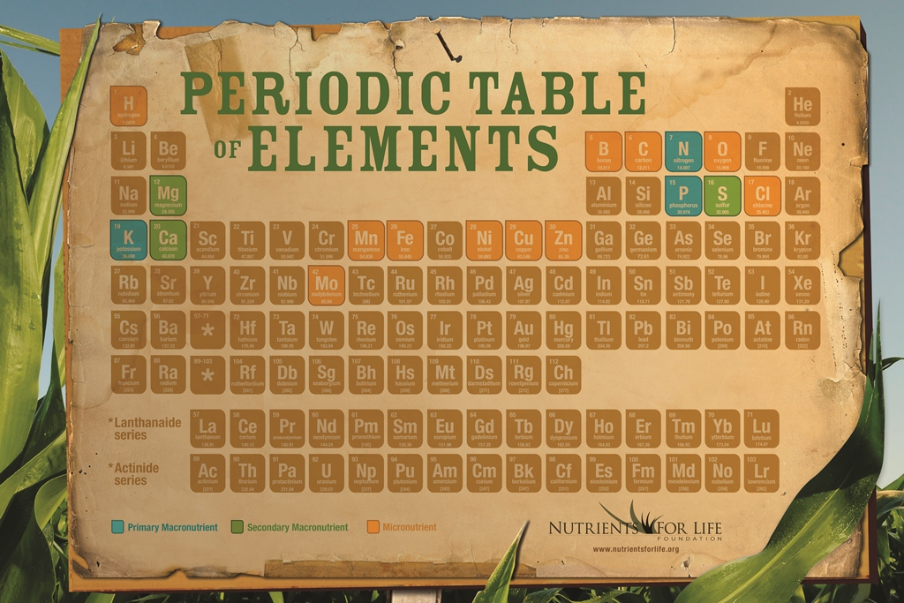
Notes:
**Optional – Print out a 8.5 x 11” copy of our periodic table poster and tape it to a cookie sheet. Use magnetic darts to have students try to hit the 17 essential elements highlighted on the poster. You can keep score, 2 points for a macro nutrient and 1 point for a micro nutrient, or just have students name the element they hit.

Slide 14
Add some pictures of you doing your job/ the facility you work in.
Notes:
We talked a little earlier about my job title, but what is it that I actually do, and how does it relate to what we just learned about N, P, and K?
** Spend some time talking about your career, how it relates to Agriculture and the fertilizer industry. What do you do on a daily basis? What kind of education is needed to have a job like yours? Feel free to add additional slides and pictures to better explain your career.

Slide 15
QUEStionS?
Notes:
Ask students if they have any questions. You may also add contact information if you would like to be available to answer additional questions.

